Slide 1
Introduction to AI
DR. AHMAD AL SALLAB,
Valeo Deep Learning Senior Expert

Slide 2
What will you learn?
What is AI?
Identify what AI can and cannot do?
AI vs. ML vs. DL
ML vs. Data science
How ML/DL works?
Global ML/DL framework
How to speak the language of AI team?
What are the steps of an AI project?
Limitations of AI
What is the effect of AI on society?

Slide 3
Agenda
Part 1: What is AI?
Part 2: Working with an AI team
Part 3: AI and the society

Slide 4
Agenda
Part 1: What is AI?
Part 2: Working with an AI team
Part 3: AI and the society

Slide 5
Where can we find AI today?
Social Media
Robotics
Computer Vision
Speech

Slide 6

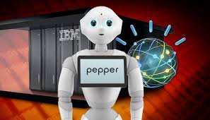

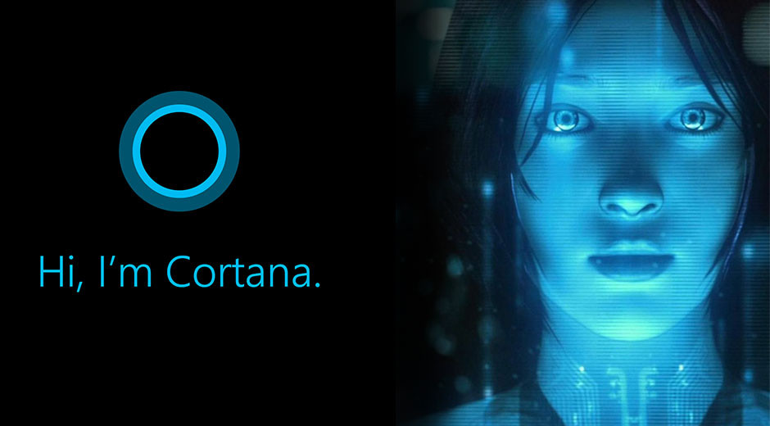
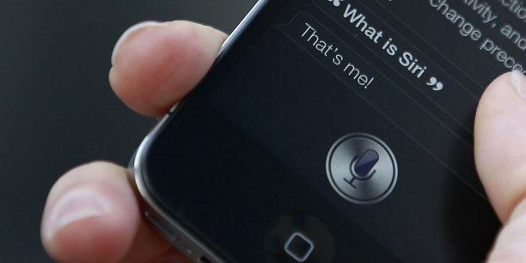
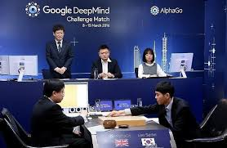
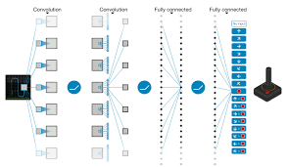

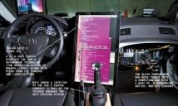
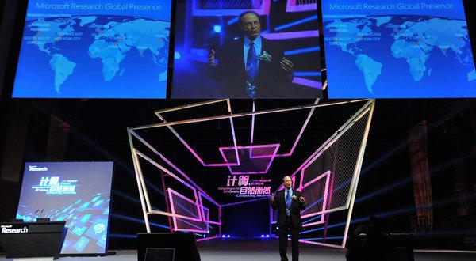
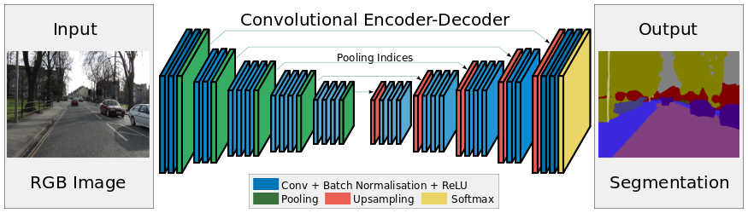
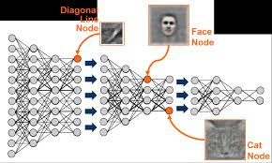
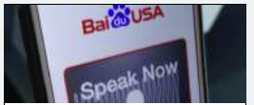
The AI revolution
Social Media
FB Chatbot
IBM Pepper
MS Cortana
Apple Siri
Robotics
DeepMind
AlphaGo
Atari
DeepMind
Computer Vision
Speech
SegNet
MS Speech
Comma.ai
HAD
AlexNet
DeepSpeech 2
Notes:
In almost all AI fields, human level intelligence is almost achieved:
Human level control Atari and AlphaGo
Human Recognition AlexNet and ImageNet
Human dialogue: Siri

Slide 7
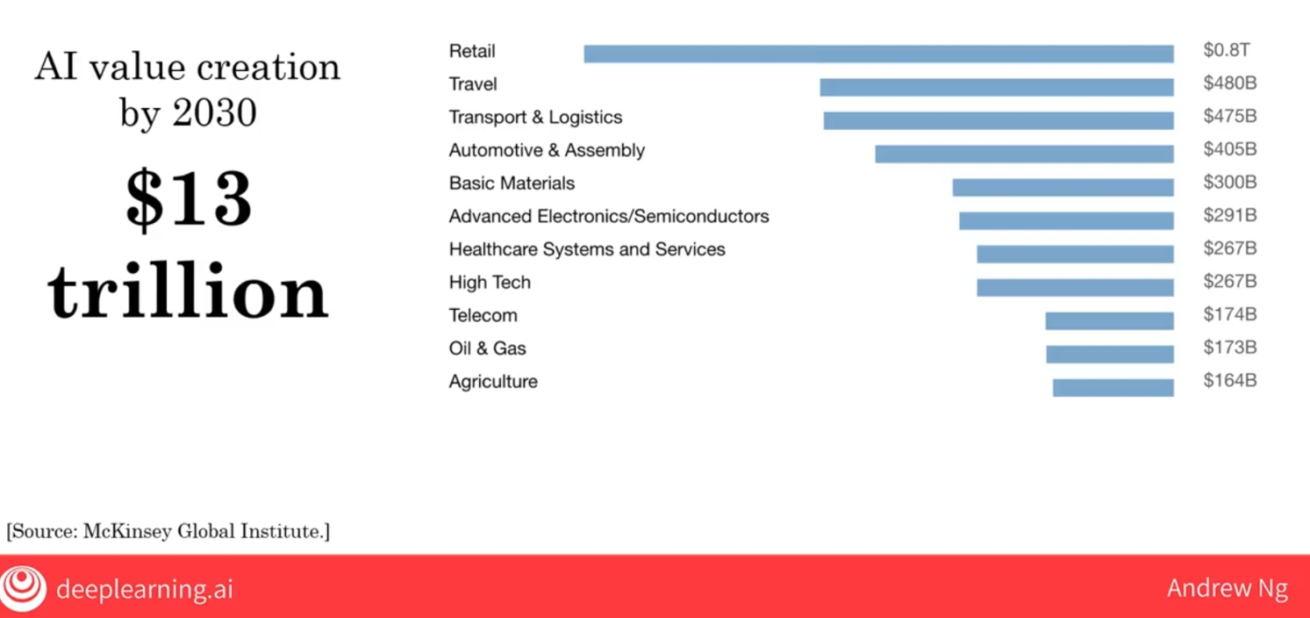
What value AI is creating?
AI is in many fields, MOSTLY not software!

Slide 8

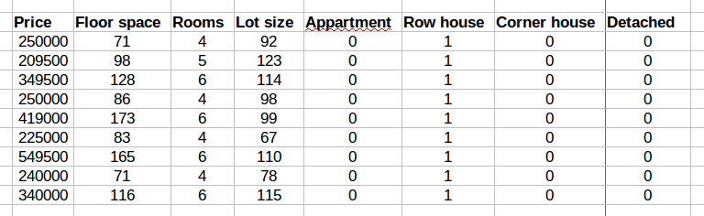
What is AI is best at today?
Supervised Learning
ML
B
A
Classification
ID
Regression
Price

Slide 9
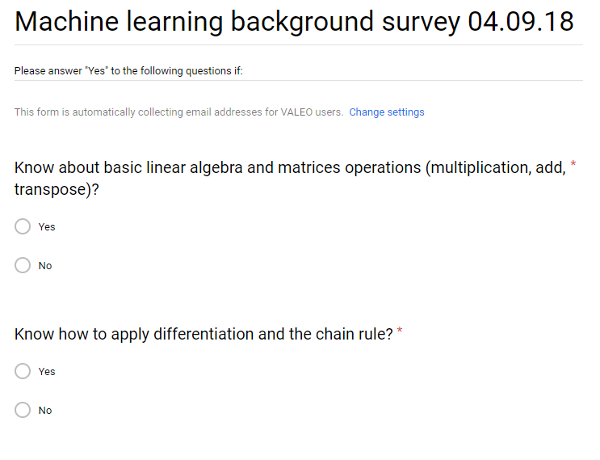
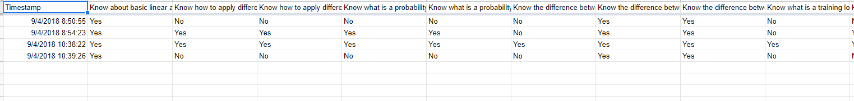
Example: Machine Learning Background Survey
Notes:
https://docs.google.com/forms/d/1VwZD1k2tvsLhq_W-HwHdbwg-13xj8eAlnZSRQMECNQ4/edit
https://docs.google.com/spreadsheets/d/1-Vwlsdikors3ZyKQZs_uADMFgakpRv3_2ANUj_-tEjo/edit#gid=0
https://docs.google.com/spreadsheets/d/13YFsyKP2elw-cDZvIrn5XnXtcjDFMY_jyMATm2n2En0/edit?usp=drive_web&ouid=101918908225833150446

Slide 10
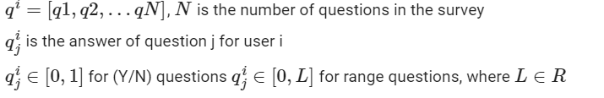
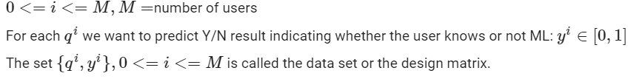
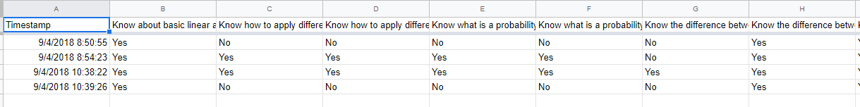
Example: Machine Learning Background Survey

Slide 11
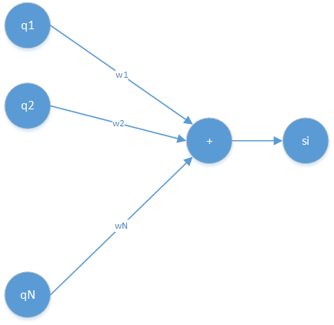
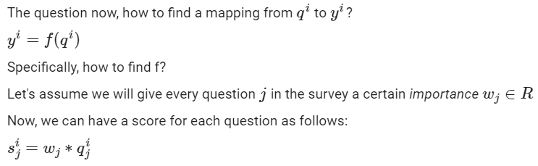
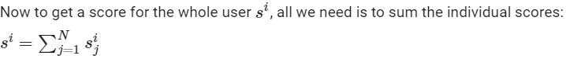
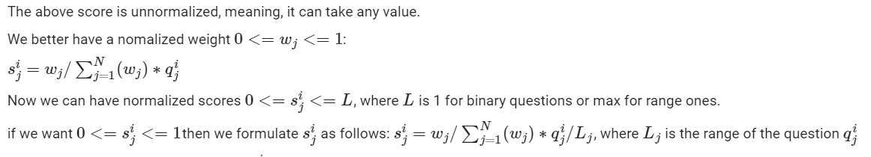
Example: Machine Learning Background Survey

Slide 12
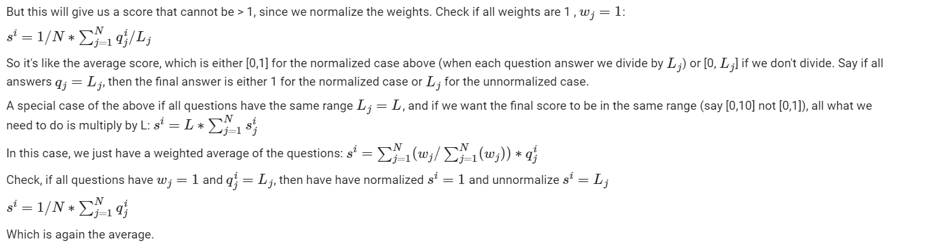
Example: Machine Learning Background Survey
Normalization

Slide 13
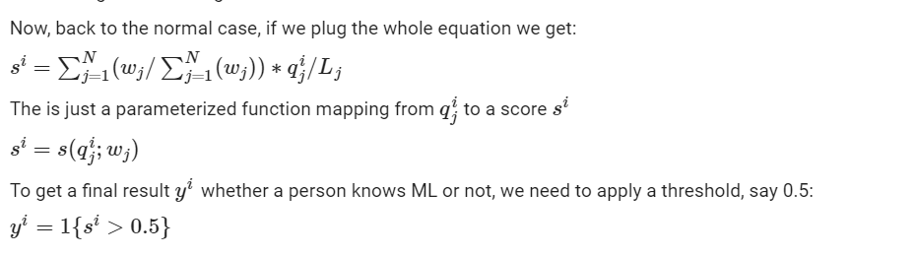
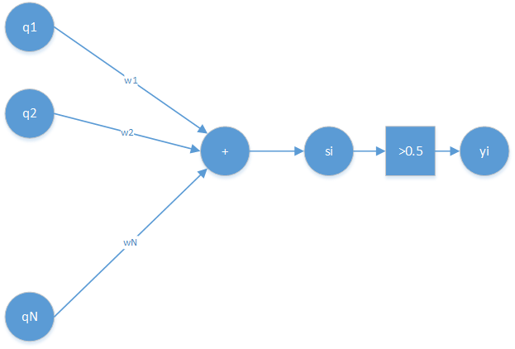
Example: Machine Learning Background Survey
1- How to find w’s and threshold?
2- How to decide on the questions q’s?

Slide 14
How to set w’s?
If the answer to this question is: "by experience or applying pre-defined rule", then you are doing rule-based AI or traditional AI.
If the answer is "we learn them" then you are doing ML.

Slide 15
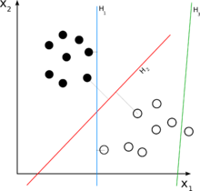
ML: How to learn w’s?
Assume only 2 q’s:
Basically → Search: ax1+bx2+c (Model)→ w1=a, w2=b, w0=c (bias, to be clear later)
Try many lines, and get the one that separates the Data better → How good? Loss
Practically→ Smarter methods (Optimizer) are used better than brute force or random search!

Slide 16
How to decide on questions?
We call the questions vector $q^i=[q1, q2,...qN]$ features vector
In case of structured data like above, normally we choose them based on experience.
In case of unstructured data like images, the input vector is just the pixel values. So the question, what are the features?
The answer to this question defines if we do ML or DL
In general, if we feed raw pixels, we do DL, if we define specific features, we do ML. This will get more clear

Slide 17
Face recognition with traditional AI
Rules
(If-else)
ID
Rule based AI

Slide 18
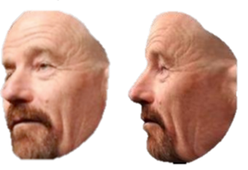
Face recognition with traditional AI
Rules
(If-else)
ID
Did you handle scale?
Did you handle Clutter?
Did you handle colors?
Did you handle pose?
Too many cases!!
Let’s Learn the rule!

Slide 19
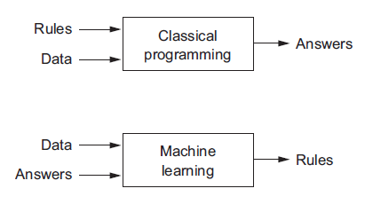
Rule based AI vs. ML
“Machine learning is the science of getting computers to act without being explicitly programmed”, Arthur Samuel 1959

Slide 20

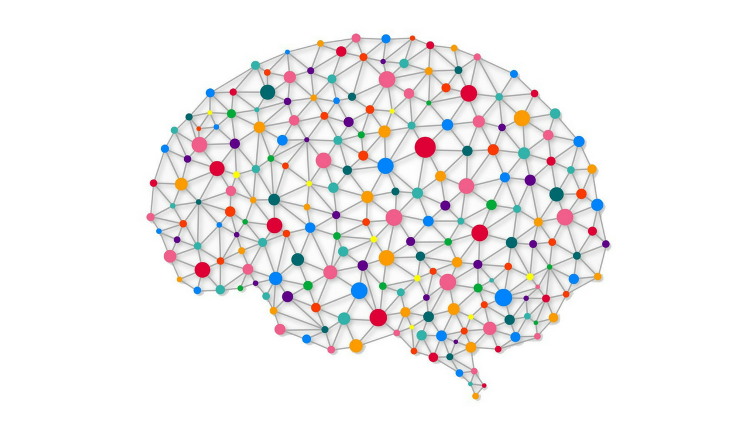
Deep Learning vs. Machine Learning
ML
B
A
B
A

Slide 21
Deep Learning vs. Machine Learning
Area
Price
Area
Year built

Slide 22
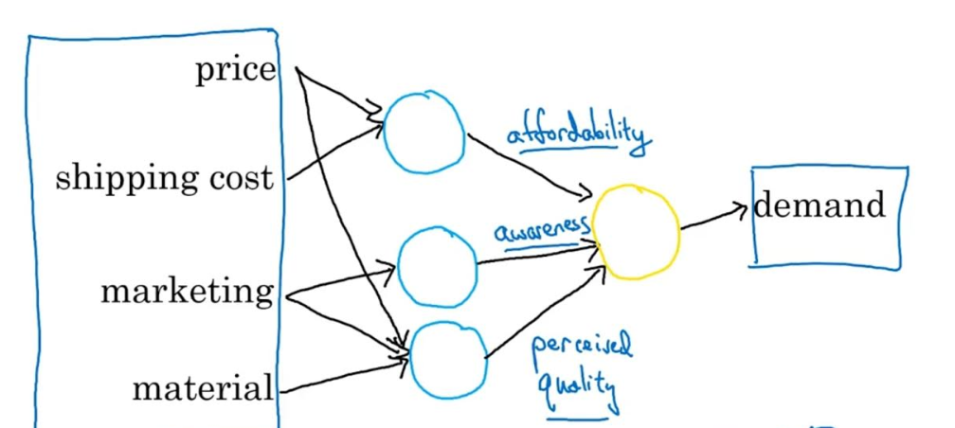
What neurons represent?

Slide 23
Deep Learning vs. Machine Learning
ID

Slide 24
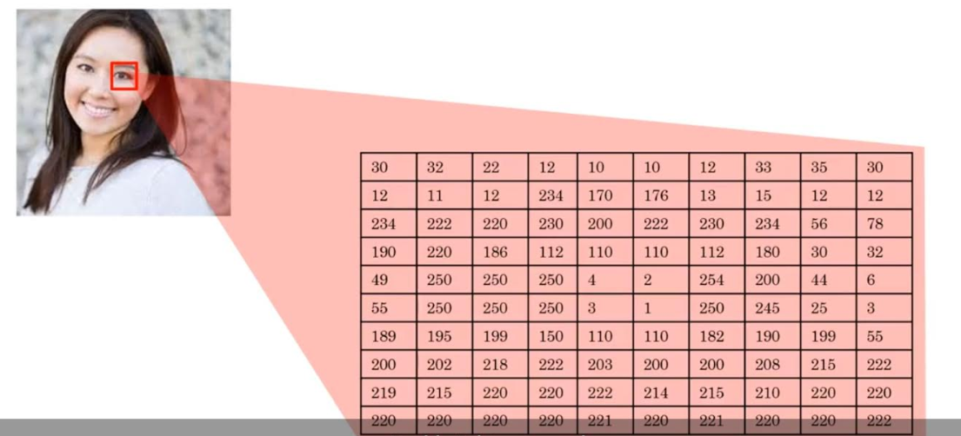
Semantic gap - What the computer can see?

Slide 25
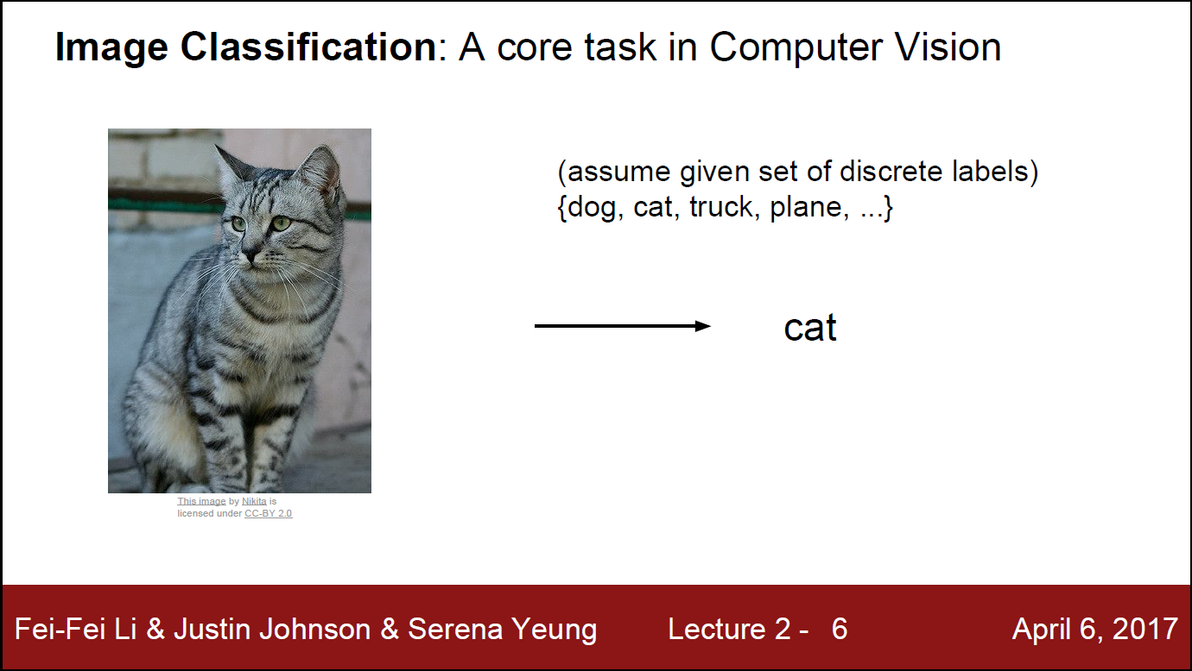

Slide 26
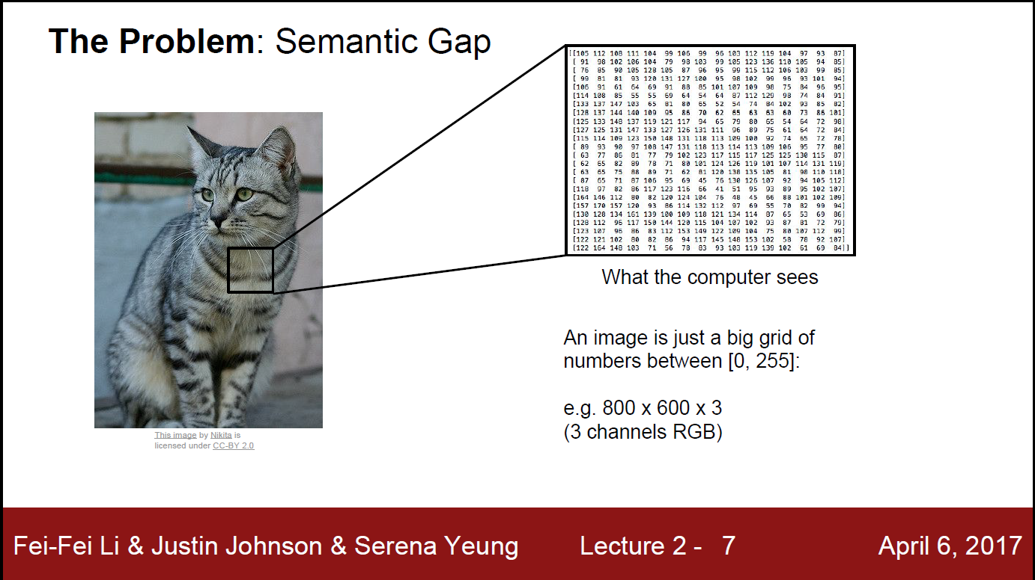

Slide 27
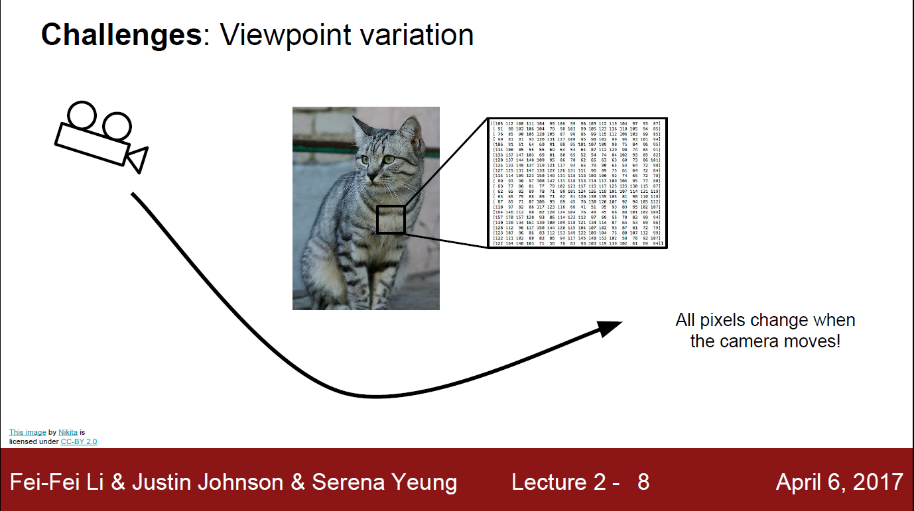

Slide 28
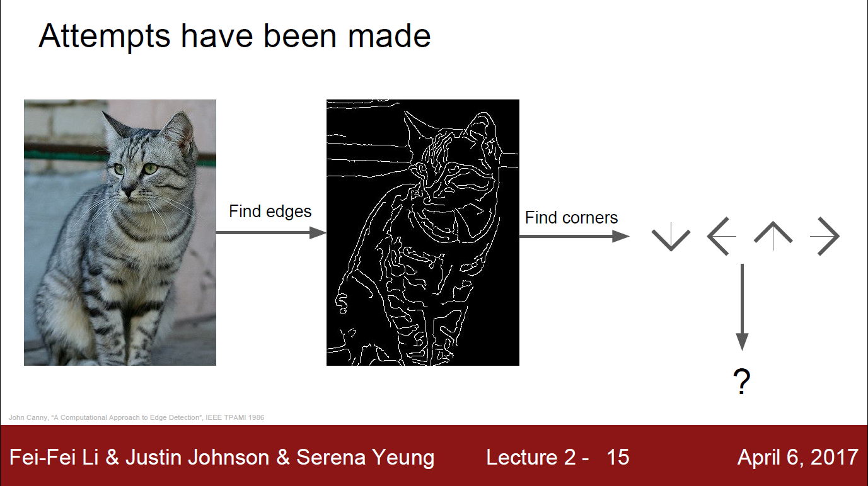
ML = manually engineered features vector
But learn the weights

Slide 29


Slide 30
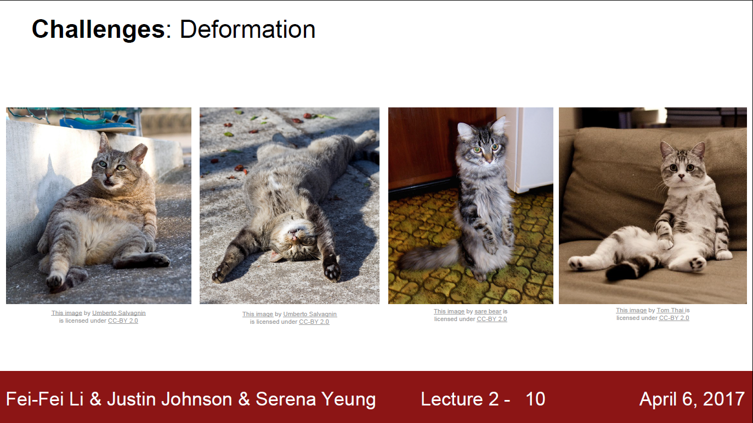

Slide 31
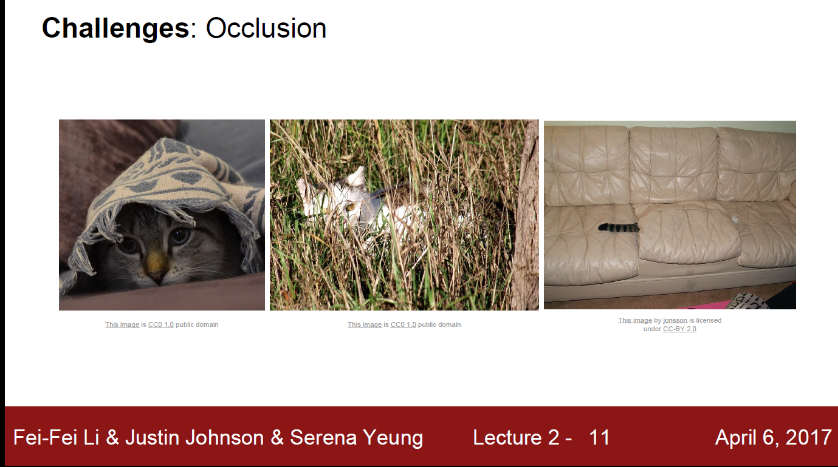

Slide 32
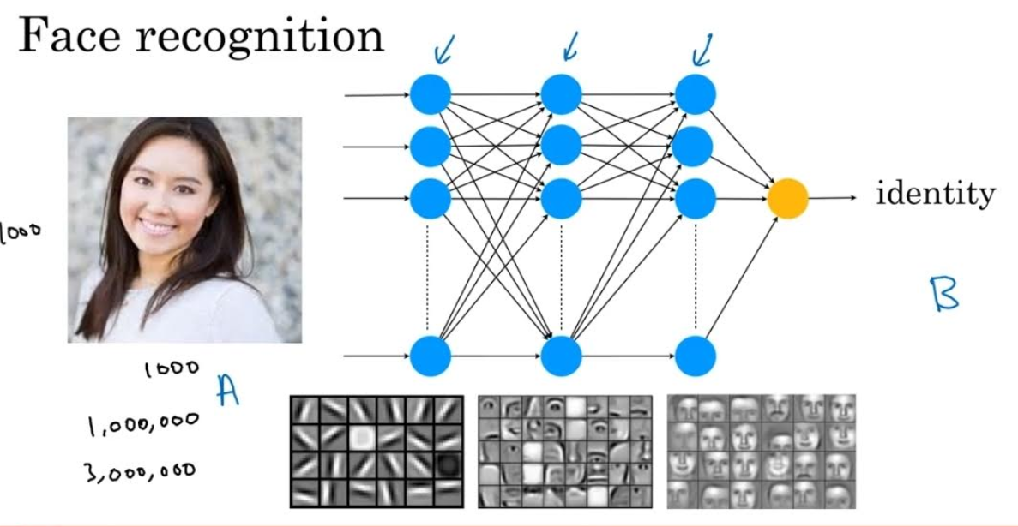
What neurons can see?

Slide 33
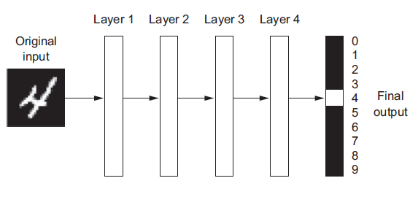
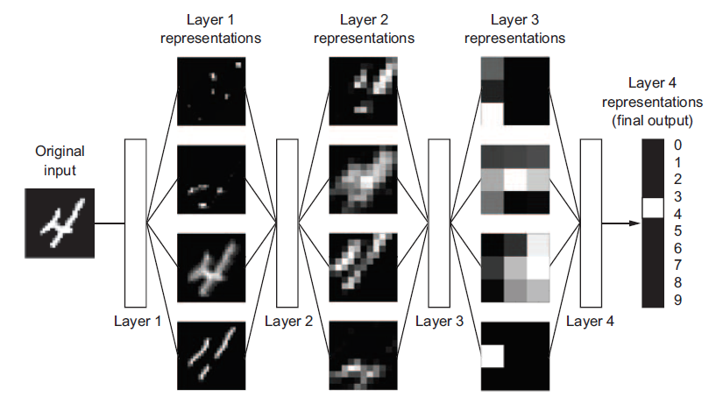
The “Deep” in Deep Learning Hierarichal Representation

Slide 34
Now we converge to a definition of Deep Learning
Deep Learning = Deep Representation Learning
“Deep learning is a particular kind of machine learning that achieves great power and flexibility by learning to represent the world as a nested hierarchy of concepts, with each concept defined in relation to simpler concepts, and more abstract representations computed in terms of less abstract ones.”
Deep Learning Book, Ian Goodfellow, Yoshua Bengio, Aaron Courville

Slide 35
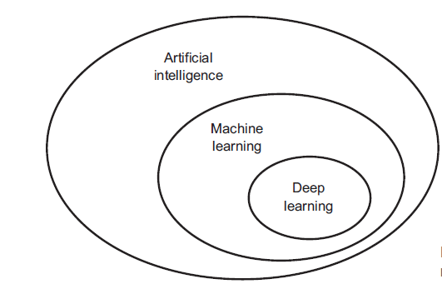
Now we can draw a line between AI, ML, Representation Learning and DL “Deep Learning Book”
https://www.deeplearningbook.org/

Slide 36
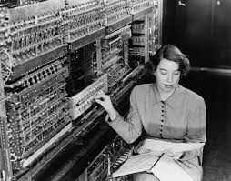
Why now?
Computer
Machine for logical and mathematical computations
1781 (Charles Babbage)
Programming
If-else
1936 (Turing Machine)
1945 (ENIAC)
Machine learning
1959 (Arthur Samule)
Problem: clutter, pose, conditions,…etc all affect the designed features vector

Slide 37
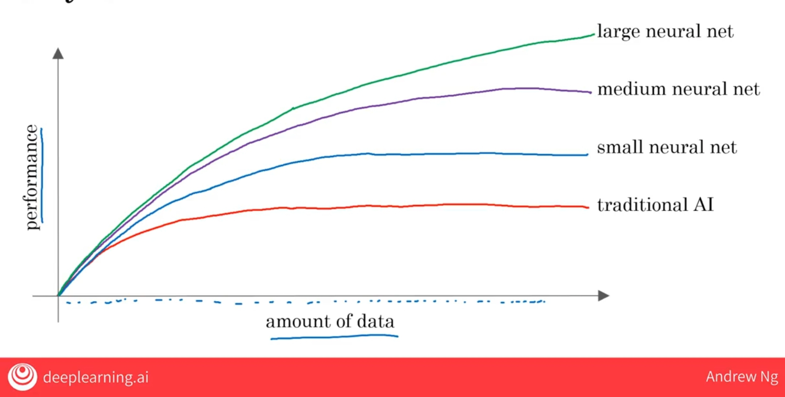
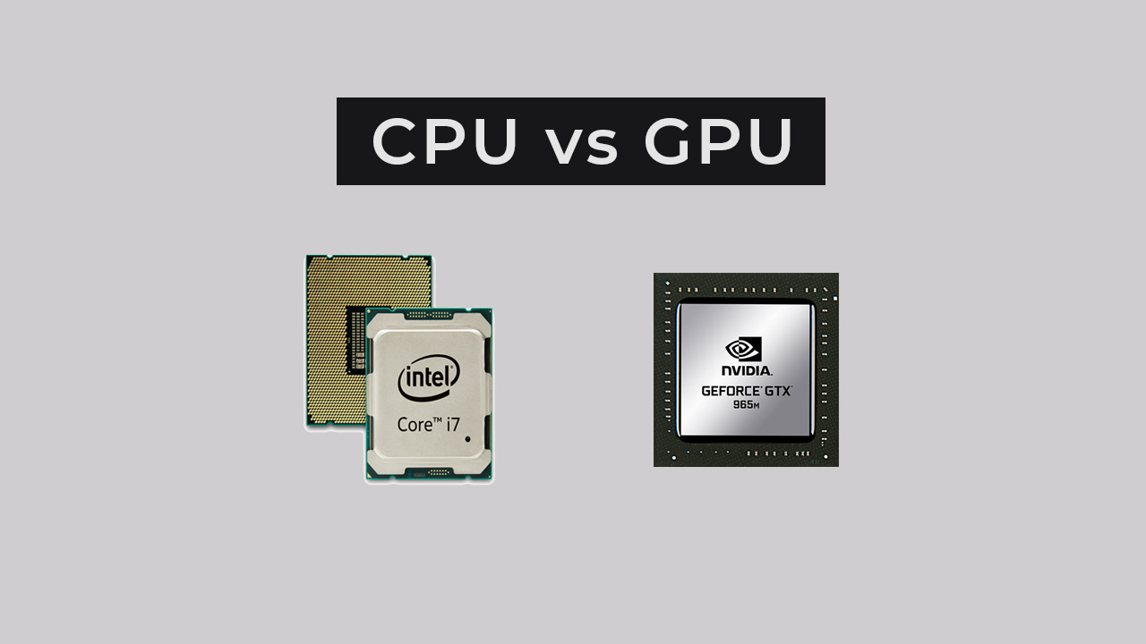
Why now?

Slide 38

Why now?
Algorithms
Learn from
Use
Powerful
Hardware
Big Data
Process

Slide 39
What other types of ML?
Supervised
Reinforcement Learning
Unsupervised

Slide 40


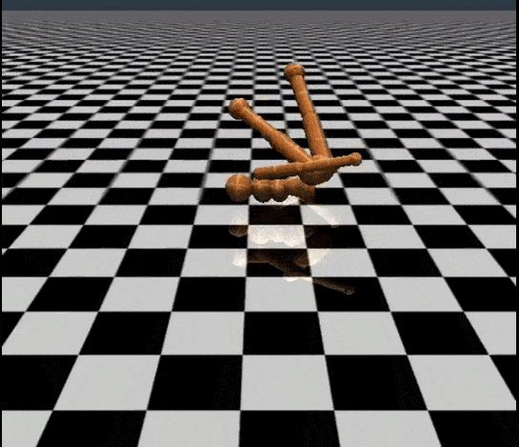
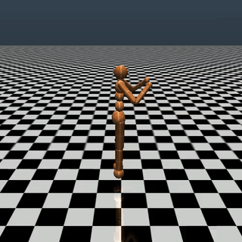
How it works? By interaction (Reinforcement)
Learning in mammals
After many attempts

Slide 41
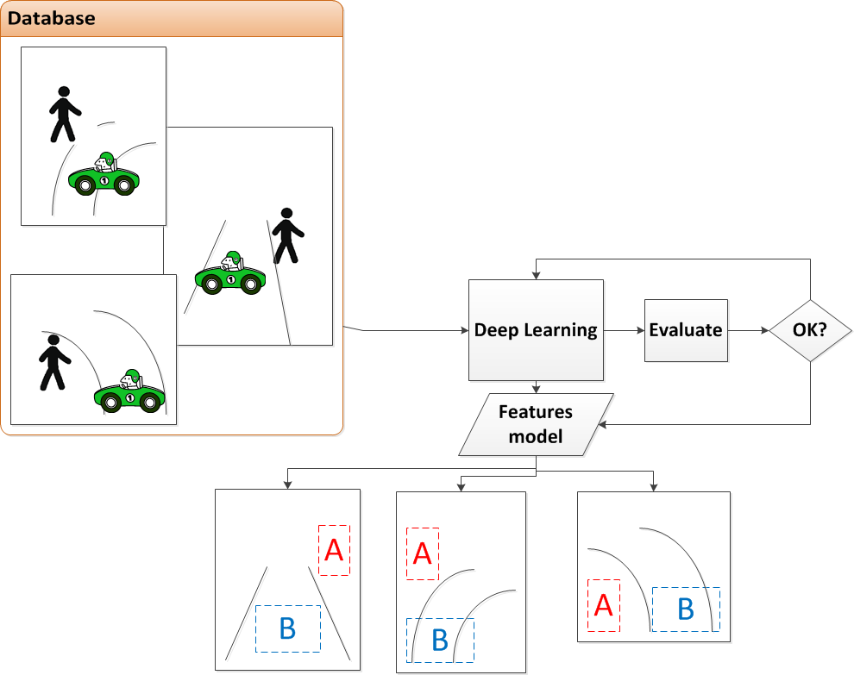
How it works? Unsupervised from big data
Notes:
Self learning machines.
Clustering is possible.
Between the lines + Flat→ Class A
Outside + Tall → Class B
Don’t know yet what are the names of the classes or what they represent
Therefore, good features could be the road curves + flat and tall bounding boxes in the specified areas

Slide 42
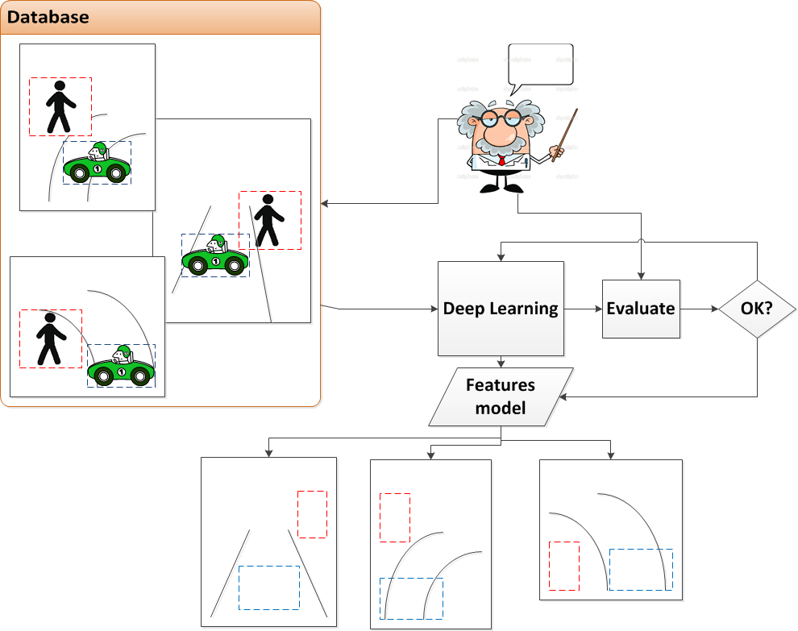
How it works? Supervised with a teacher

Slide 43
How DL works? Ingredients
Data:
X, Y (supervised)
Model: function mapping:
Y’ = fw(X), w=1,2,…etc,
Loss:
How good Model fits Data?-> Y vs. Y’
Optimizer:
search for best fw, that makes the Model fits the Data with min. Loss.

Slide 44
ML: How to learn w’s?
Assume only 2 q’s:
Basically → Search: ax1+bx2+c (Model)→ w1=a, w2=b, w0=c (bias, to be clear later)
Try many lines, and get the one that separates the Data better → How good? Loss
Practically→ Smarter methods (Optimizer) are used better than brute force or random search!

Slide 45
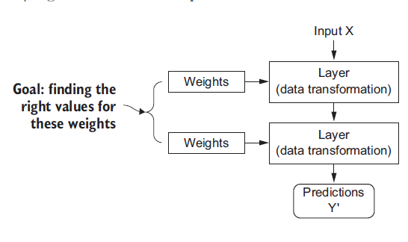
How DL works? 1. Model

Slide 46
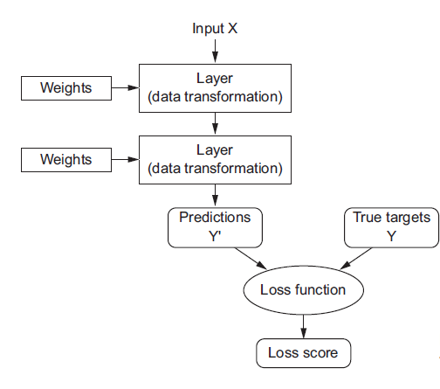
How DL works? 2. Data

Slide 47
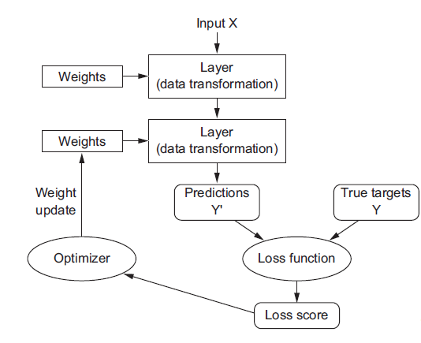
How DL works? 3. Loss 4. Optimizer
Optimizer does the “search”
Using backpropagation

Slide 48
Global ML/DL framework
Output
Wcls
Decision
Wfeatures
Features
Manual = Hand crafted = Engineered = ML
Auto = NN = DL
Input

Slide 49

Transfer Learning

Slide 50

Transfer Learning - How is it possible?

Slide 51


Data science vs. Machine Learning
ML: “Make computers learn rather than explicitly programmed”, Arthur Samuel 1959
DS: “Science of extracting Knowledge and insights from data”
Output is software
Looking at market data, what is the best sales strategy?
Output = slide deck supporting decision making
“Speak with Data”

Slide 52
Data science vs. Machine Learning
Data Science

Slide 53
Agenda
Part 1: What is AI?
Part 2: Working with an AI team
Part 3: AI and the society

Slide 54
How to speak the language of AI team
What AI can and cannot do
AI project lifecycle
Define the performance requirements
Data needs

Slide 55

What AI can NOT do?
Artificial General Intelligence is very far (10/100/1000 yrs)
Notes:
AGI
https://www.topbots.com/wp-content/uploads/2017/09/agi_out_of_reach_1600px_web-1280x640.jpg

Slide 56




What AI can do?
Structured data
Unstructured data
Artificial Narrow Intelligence: Structure or unstructured

Slide 57

What AI cannot do? Complex mappings
Gestures could be hard even sometimes for humans

Slide 58
How to quickly spot the potential of AI to a project?
Simple task for human → simple concept
< 1 sec
And/or needs lots of data to perform
Think Tasks not Jobs
Instead of replacing an operator, think of how AI can automate parts of his job
Examples:
Simple perception: text, speech, image
Automation: Look at many data and predict say house price

Slide 59

Workflow of an AI project
AD pipeline
Each is an AI project: A --> B
Data collection
Train
Many iterations
Deploy

Slide 60

How to define performance requirements?
Always talk in a statistical metrics
100% is not possible due to reasons that will be described later

Slide 61
How to acquire data?
Raw data collection, where?
Public
Own
From users experience (early deployment)
Annotation = Labeling
Manual
Automatic → Observe behaviors
Semi-automatic

Slide 62
Data acquisition tips
Integrate AI teams
Quick feedback
Set data collection requirements and quality
Deploy early (Tesla model)
Do not wait years to collect all the data
Quick feedback
Notes:
Integrate AI teams
Set data collection requirements and quality
How many classes
Balance
Conditions,...
Quick feedback
Deploy early (Tesla model)
Do not wait years to collect all the data
Quick feedback

Slide 63
How much data?
Usually BigData → How big?
The bigger the better → MB, GB, TB, PB
Problem dependent
Rule of thumb, 5k/class → if classification

Slide 64

What data sets an AI team needs?
Train data
Test data
Validation data

Slide 65

100% is not possible
Garbage in - Garbage out
Incorrect labels
Missing values
Ambiguous labels
ML limitations
Statistical methods
Traditional ways fails due to many cases
Notes:
Integrate AI teams
Set data collection requirements and quality
How many classes
Balance
Conditions,...
Quick feedback
Deploy early (Tesla model)
Do not wait years to collect all the data
Quick feedback

Slide 66






AI Technical tools
ML frameworks: TensorFlow, Pytorch, Keras, CNTK,...etc
Linux
Opensource: Github → critical for fast prototyping. Most of the ideas are from research papers.
GPU vs CPU
Cloud vs. On-prem

Slide 67
Make or buy?
ML can be in-house or outsourced
Most probably it will soon be an industry standard
Data science (analytics) are better in-house → custom
Embrace the industry standards → re-use when possible
Do not reinvent the wheel

Slide 68
Agenda
Part 1: What is AI?
Part 2: What is an AI project?
Part 3: AI and the society

Slide 69
AI and Society
Hype of AI
Limitations of AI
Bias
Adversarial Attacks
Effect on Jobs

Slide 70
The hype of AI
AGI is too far
AI cannot do everything
There’s no need to fear it! This creates limitations
AI winter is too far as well
AI is creating lots of gains in economy already

Slide 71

Limitations of AI
Explainability
Humans also have hard time explain themselves, but are less susceptible to errors

Slide 72


Limitations of AI
Gender bias
Bias
https://course.fast.ai/

Slide 73


Limitations of AI
Ethnic bias
Bias
https://course.fast.ai/

Slide 74
Limitations of AI
Why is it a problem?
AI is involved in hiring, so hiring can be biased
Facial recognition works better for light-skinned than dark-skinned, and is used in security departments
Bank loan approvals
Can lead to wars!

Slide 75
Limitations of AI
How to deal with bias?
Technical solutions: collect balanced data
Auditing: frequently test cases of bias from your algorithm
Diverse workforce: creates less biased applications

Slide 76

Limitations of AI
Adversarial attacks
AI does not see as we see
Adversarial defense
Technical solutions exists, but with cost of slow running time
Still in research phases

Slide 77
Limitations of AI
Mis-use of AI
Deep Fakes https://www.youtube.com/watch?v=cQ54GDm1eL0
Fake videos of people
Manipulate freedom
Oppressive surveillance
Elections manipulation through personalized content
Fraud (anti-fraud) attacks

Slide 78


AI Effect on jobs

Slide 79
Take away messages
ML is data driven
Global ML workflow
DL is more data driven + HW driven → Why now? GPU
AI is good at simple perception tasks and automation using analysis of tons of data
AI is not good at complex tasks. AGI is far.
Think statistical metrics. 100% is not possible.
AI Hype and Limitations: Bias, Attacks

Slide 80
References
https://www.coursera.org/learn/ai-for-everyone
https://www.coursera.org/learn/machine-learning-projects
https://course.fast.ai/
https://www.deeplearningbook.org/

Slide 81

QUESTIONS

Slide 82


